Slide 1
React JS
Pravinkumar R. D.

Slide 2
Agenda
What is React JS?
Features of React JS
How to get React JS?
Introduction to React JS Component
Introduction to JSX

Slide 3
What is React JS?
It is a JavaScript library for building User Interfaces
It is developed by Facebook
The most popular JavaScript library with large community support
Can be used as V from MVC
Can be used on client as well as server

Slide 4
Features of React JS
It follows web standards like Component based development using React way
It supports ES5 and ECMA2015 during React development
JSX is a preferred way writing React Components
Virtual DOM – Representation of DOM is kept in memory

Slide 5
Features of React JS
It offers declarative way to program user interfaces
React can also render on Server using node and power mobile apps using React Native
Communication between components is made easy using PROPs
React components maintains its own state
Unidirectional Data Flow – One way data flow

Slide 6
Features of React JS
It offers number of Lifecycle methods which you can use to run your application logic
React has its own unique way of handling events on DOM elements
You can do conditional rendering of components depending on the state of the application
React follows “controlled component” when working with Forms

Slide 7
Features of React JS
React has some built-in type checking abilities with the help of propTypes
Model validation

Slide 8
React Component
Different ways to create components in React –
ES5
createClass function
Stateless function
ES6/ECMA2015
Class
Stateless function

Slide 9
ES5 Class Component
var CompanyMessage = React.createClass({
render: function () {
return (<h1>Welcome To Synechron World!</h1>);
}
});

Slide 10
ES6 Class Component
class CompanyMessage extends React.Component {
constructor(props) {
super(props);
}
render() {
return (<h1>h1>Welcome To Synechron World!</h1>);
} }

Slide 11
ES5 Stateless Component
var CompanyName = function(props) {
return (<h1>Welcome To Synechron World!</h1>);
});

Slide 12
ES6 Stateless Component
const HelloWorld = (props) => {
return (<h1>Hello World</h1>);
});

Slide 13
Advantages of Stateless Components
Class is not required
Enforces best practices
Don’t use “this” keyword
Understanding becomes easy
Maintenance becomes easy
Testing becomes easy
Performance is higher

Slide 14
Class Components
Use class components –
To maintain the state of the component
To use refs
To use lifecycle methods

Slide 15
What are Container Components?
The container components –
Has few or no markup
Who pass the data and actions down
Knows about the store [Redux]
Are stateful components

Slide 16
What are Presentation Component?
The presentation components –
Contains all markup
They receive the data and actions from props
Don’t know about the store [Redux]
Are functional components

Slide 17
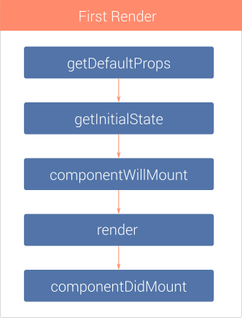
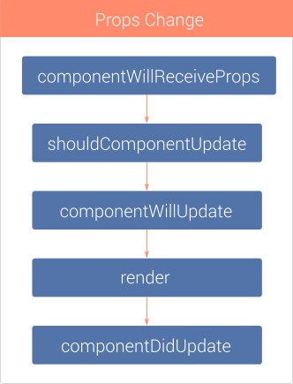
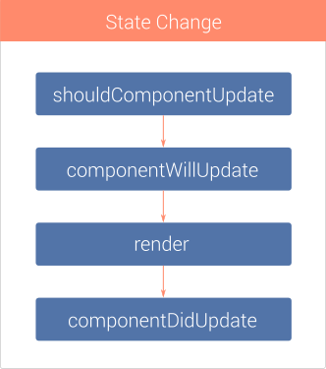
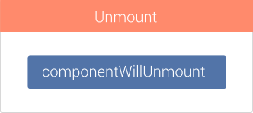
Component Lifecycle Methods

Slide 18
Props & State in React
Similar to function arguments
Props are used to pass the data to child components
Props are immutable
State is declared in container components
State can be modified by –
Actions, network calls or others
Set initial state in a constructor

Slide 19
Why Redux?
App Component
Employees Component
JphPosts Component
EventsList Component
EventDetails Component

Slide 20
Introduction to Redux
Store

Slide 21
How does it work?
Dispatch
Action
Handle Action,
Change State
Reducer(s)
Subscribe
Pass State
Store
Component
State

Slide 22
What is Redux?
State Container for JavaScript Applications
Consistence behaviour –
Client, Server and native application
Easy Testing
Stores state of an application as an object tree
Change state only by actions
Changes are made with pure functions –
Reducers

Slide 23
Actions
Payloads of information which sends data from application to store
The only source of information for the store
Plain JavaScript objects
They must have Type property
Value of type property should be string

Slide 24
Reducers
Specify how the application’s state changes in response to actions
Reducers are pure functions
Rules –
No API calls
No Mutations
No side effects

Slide 25
Store
Only one store in redux application
Holds application state
Allows access to the state
Allows state to be updated via dispatch(action)
Registers listeners via subscribe

